Slide 1


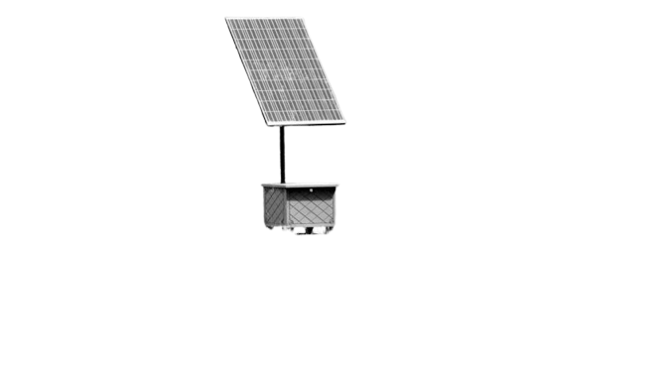

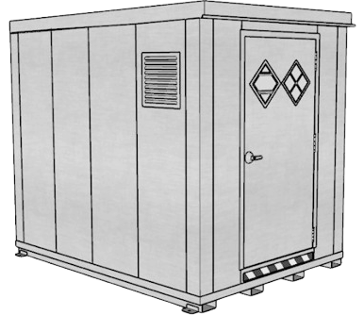
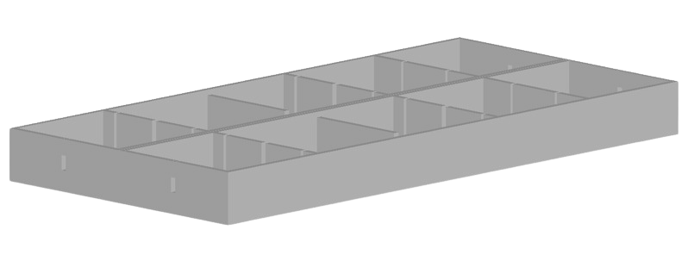
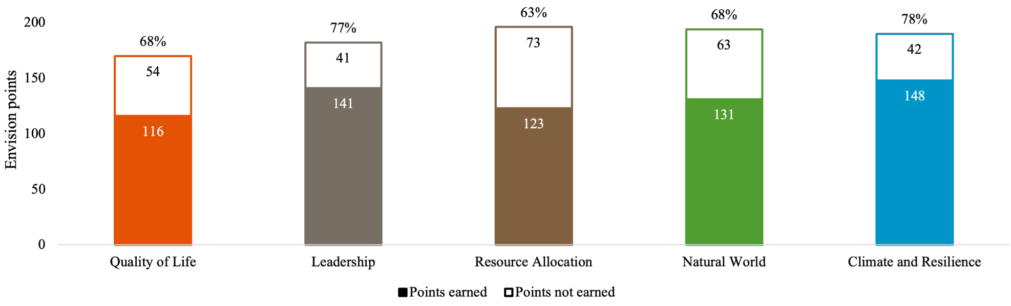
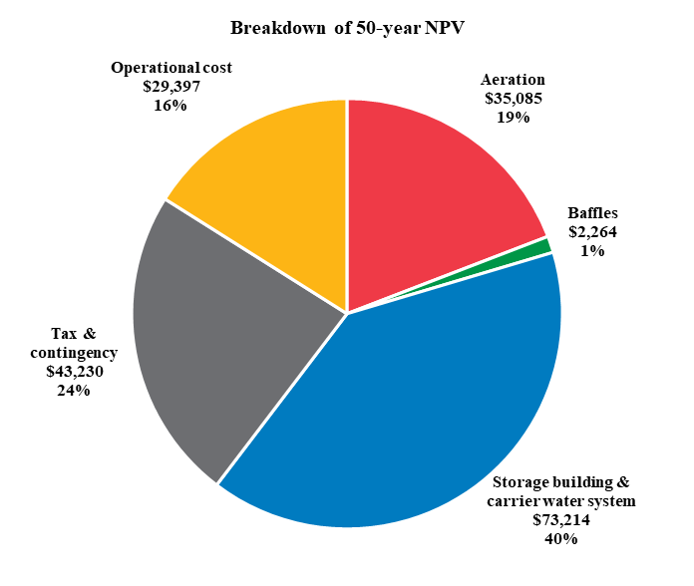
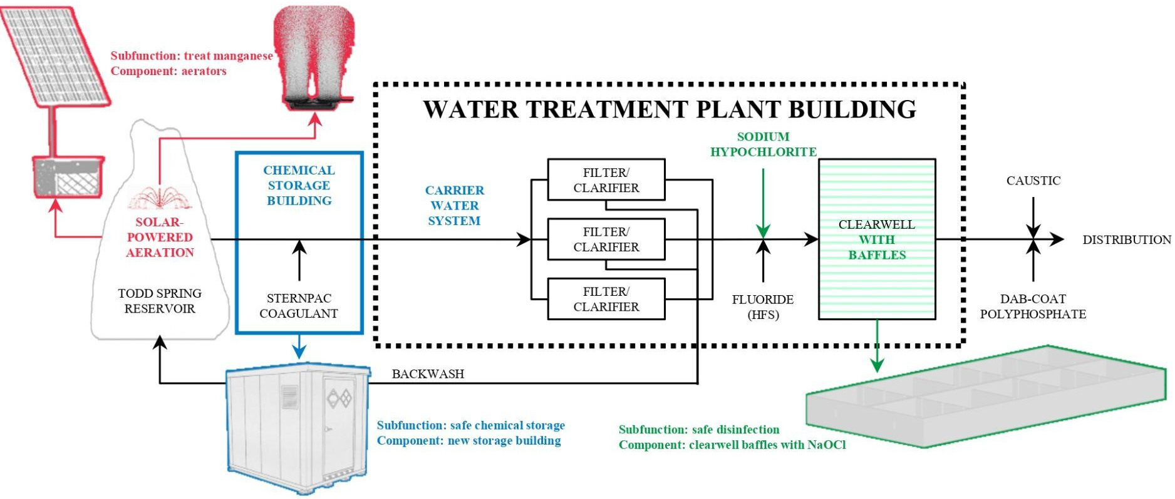
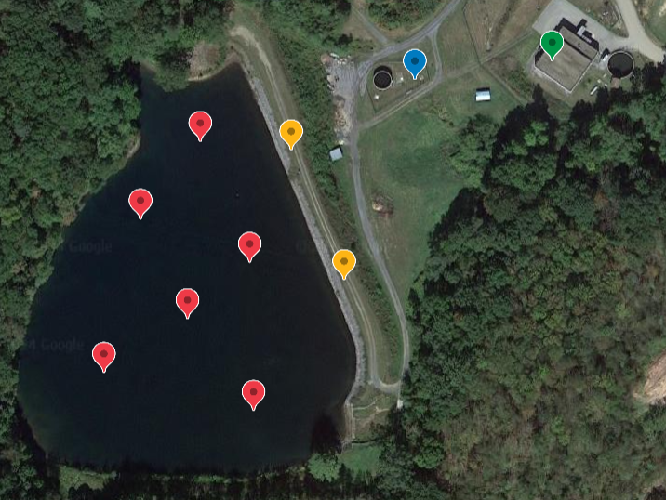
Bedford borough WATER TREATMENT PLANT UPGRADES
Got Manganese?: Carmen Hagerty, Kate Hanson, Samantha Lee, Flannery McNair, Shria Shyam
12-401: CEE Design | Profs. Sarah Christian and Fethiye Ozis | Technical Advisor: Tyler McGraw | Fall 2024
We are grateful for the support of Professor Sarah Christian, Professor Fethiye Ozis, technical advisor Tyler McGraw (Stiffler McGraw), and John Whitmore (water treatment plant superintendent).
Problem definition
Scan for sources and more information.
Design details
PROBLEM: Bedford Borough struggles with high-manganese water,
uses unsafe disinfection, and has non-compliant chemical storage.
SOLUTION: The following components are proposed to mitigate
the problems at the Bedford Borough Water Treatment Plant.
SUBFUNCTION 1: Produce effluent with manganese concentration < 0.05 mg/L.
Codes: Safe Drinking Water Act (USEPA 2015)
Solar-powered bottom-up aerators are installed in the reservoir to prevent manganese mobilization. Dissolved oxygen sensors help optimize aerator operation.
FUNCTION: Treat and supply potable water to Bedford Borough.
SUBFUNCTION 2: Provide a safe
location for chemical storage.
Codes: National Fire Protection Association (NFPA)
Solar-powered aerator (ProLake 2024).
Aerator (Living Water Aeration 2024).
A prefabricated chemical storage building is installed at the raw water site. A new carrier water system transports chemicals from the new building to their delivery points.
Chemical storage cabinet (USA Safety 2024).
SUBFUNCTION 3: Provide a
means for safe disinfection.
Codes: 4-log removal of viruses guidelines (PA DEP 2015)
Baffles are added to the reactor to improve disinfection efficiency. Chlorine gas is replaced with safer sodium hypochlorite.
CONSTRAINTS:
The cost cannot exceed the $3 million budget.
The treated water must satisfy EPA regulations.
The design must account for existing infrastructure and topography.
Baffle design, this proposal.
THE PROPOSED DESIGN MEETS ALL CONSTRAINTS.
The 50-year net present value (NPV) is estimated as $183,190.
Sufficient oxygen is provided to immobilize metals below the EPA limit.
The design adds onto existing infrastructure and topography.
Performance summary
OBJECTIVE 1: MAXIMIZE SUSTAINABILITY.
The Envision framework guides sustainable infrastructure projects.
Envision Performance of Proposed Project
Lower chemical use and safer disinfection improves performance in quality of life, leadership, natural world, and climate and resilience.
Solar panels improve resource allocation through renewable energy.
OBJECTIVE 2: MINIMIZE COST.
Baffles increase disinfection efficiency, lowering annual chemical costs.
Solar panels eliminate annual electricity costs for aeration.
Prefabrication lowers construction costs for the chemical storage building.
Capital cost | $153,793
Capital cost includes aeration, baffles, storage building & carrier water system, and tax & contingency.
Annual operational cost | $2,130
50-year NPV | $183,190
DESIGN OVERVIEW
Diffusers
Solar-powered aerators
Storage building
Clearwell in treatment plant
Site map (Google Earth 2024).
Future work
LESSONS LEARNED
Emerging pollutants may require new water treatment processes.
Future water treatment regulations may necessitate additions.
Future maintenance will keep systems updated and functional.
Nature-based solutions (e.g., aeration) can help decrease chemical use.
Solar panels increase capital cost but decrease operational cost.
Pipes can follow natural slopes to eliminate pumping requirements.

